Slide 1
DAY-4 PPT
LINUX DEVICE DRIVER TRAINING – COMMANDS
-GAZAL

Slide 2
cat and echo command
Use cat to display file contents to the terminal:
$ cat bears
$ cat bears7
$cat bears bears7
“cat” is short for concatenate. The “cat command takes one or more files and concatenates their contents to standard output.
echo is used to output arbitrary text to the terminal:
$echo ‘hello world’
$echo without single quotes
Echo ‘hello world’ > MyWorld

Slide 3
cp command
This command in Linux is used to copy files and directories from one location to another.
Its basic syntax is: cp [options] source_file destination
Options are-
-r or –R: Copies directories recursively.
-i : Prompts before overwriting existing files.
-v : Provides verbose output, showing each file as it's copied.
Example1 Copy a file to another location:
cp file1.txt /path/to/destination/
Example2 Copy multiple files to a directory:
cp file1.txt file2.txt /path/to/destination/
Example3 Copy a directory and its contents recursively:
cp -r directory1 /path/to/destination/

Slide 4
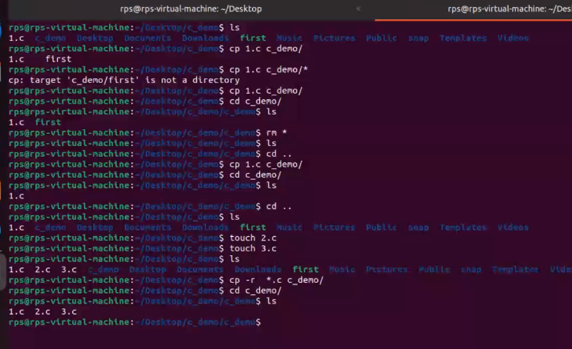
Running cp command

Slide 5
WILDCARDS
With many linux commands you can use wildcards to match characters.
The ‘*’ can be used to match zero or more characters
Examples:
$ ls bear* -list all files starting with bear
Bears bears7 bears_Chicago
$ls *bear*-list all file starting with and end with bear
Bear bears7 bears_Chicago polarbears
The ‘?’ can be used to match exactly one character
$ls bears?
bears7

Slide 6
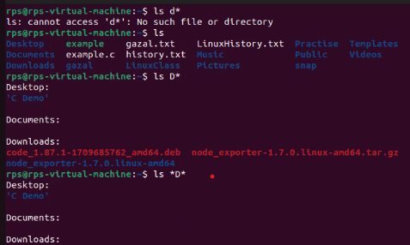

Using wildcards

Slide 7

File command
The file command tells us what type of file it might be – text, executable, PDF, jpg, gzip
$ file read-write.txt
$ file world.exe
$file examples

Slide 8
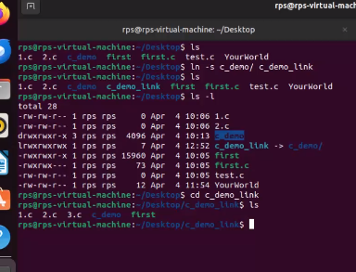
Creating reference link
Allowing reference of same file with different name or path –a symbolic link is a another file type.
$ln –s <existing_file> <file_link>
This is how we create reference link:
syntax

Slide 9
rm and rmdir command
rm : command stands for "remove." It is used to delete files and directories. The basic syntax is: rm [options] file
options are:
-i : Interactive mode, prompts for confirmation before deleting each file.
-r or –R : Recursively deletes directories and their contents.
rmdir : command stands for "remove directory." It is used to delete empty directories. The basic syntax is: rmdir [options] directory.

Slide 10
Changing Permissions and Ownership
Use ‘chmod’ to change the file permissions:
chmod [ugoa][+/-][rwx] filename
where u=user, g=group, o=others or world and a=all three
For example, to provide group read access to a file:
$ chmod g+r myfile
Or to remove file access to another than the owner or group members (in other words, others):
$ chmod o-rwx myfile
The ‘chown’ command is used to change file ownership and the ‘chgrp’ command can change group ownership of a file. As a regular user, you can not change the ownership of a file, but you can change the group ownership if you are a member of the group to which you are changing the group ownership
You can use the –R argument on any of the above to recursively make changes on a directory of files

Slide 11
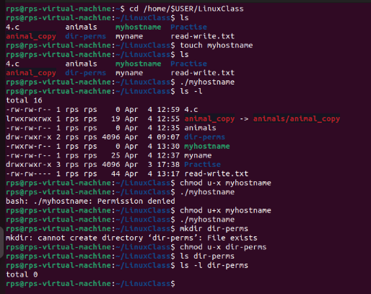
Showing Changing permission in terminal

Slide 12
More and less commands
More : this command is a basic pager that allows you to view text files one screenful at a time. It is especially useful for large files because it doesn't load the entire file into memory all at once.
Syntax: $ more mascots.txt
Less : command is an improved version of ‘more’. It provides more features and allows you to navigate through files more efficiently. It loads the entire file into memory, allowing backward movement as well.
Syntax : $ less mascots.txt
$ more mascots.txt and $ less mascots.txt - each prints out a page of a file at a time

Slide 13
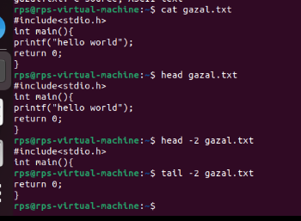
head or tail command
$ head mascots.txt :
prints out the first 10 lines by default.
Can use the –n argument to change the default number of lines
$ tail –20 mascots.txt :
prints out the last 20 lines

Slide 14
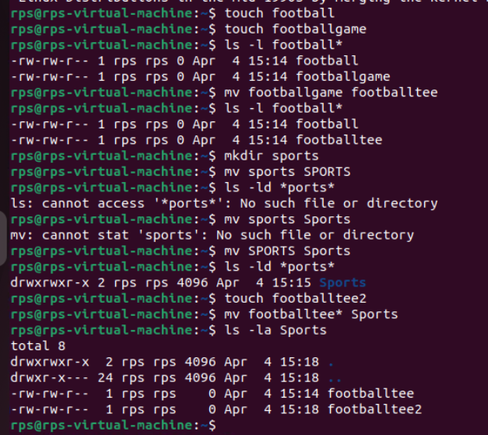
Moving files and directories
mv – move one or more files or rename a file
Syntax : mv source destination

Slide 15
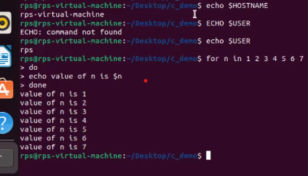
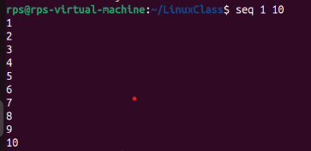
Shell scripting
Shell scripts are plain text files containing a series of shell commands. You can create them using any text editor.

